Slide 1
GDC Culture Committee

Slide 2
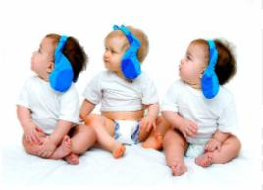
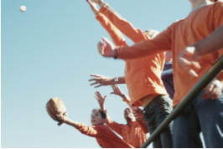

What GDC Culture committee do
We’ll find creative ways to recognize people’s achievements
We’ll enhance GDC reputation as a great place to work
We’ll have FUN in the pursuit of improving employee satisfaction
We’ll contribute to retention, open communications and teamwork
. . .
Fun
Creativity
Teamwork

Slide 3
Sponsor for Award and Activity
Spot award
Extra Mile award
Best trainer
Best interviewer
Birthday celebration
New hire welcome activity
International marathon

Slide 4

Perficient Award
Award | why doing this | Who can be nominated
Spot award | The spot award reflects the spirit of empowerment and mentoring inherent in the Perficient Promise. Employees that continually do great work day to day will be rewarded for it | Any full-time China GDC employee is eligible to receive a Perficient Spot Award
Extra Mile Award | Perficient believes in a commitment to excellence and in rewarding outstanding behavior! | You can nominate any colleague (except yourself!) Executive Team are not eligible for this award
Best trainer | To recognize great contributor for GDC training and recruiting | The best trainer is based on the training quantity, average of scores and attendance in one quarter.
Best interviewer |  | Who did the most interviews base on the interview hours(Campus & social) in one quarter.

Slide 5
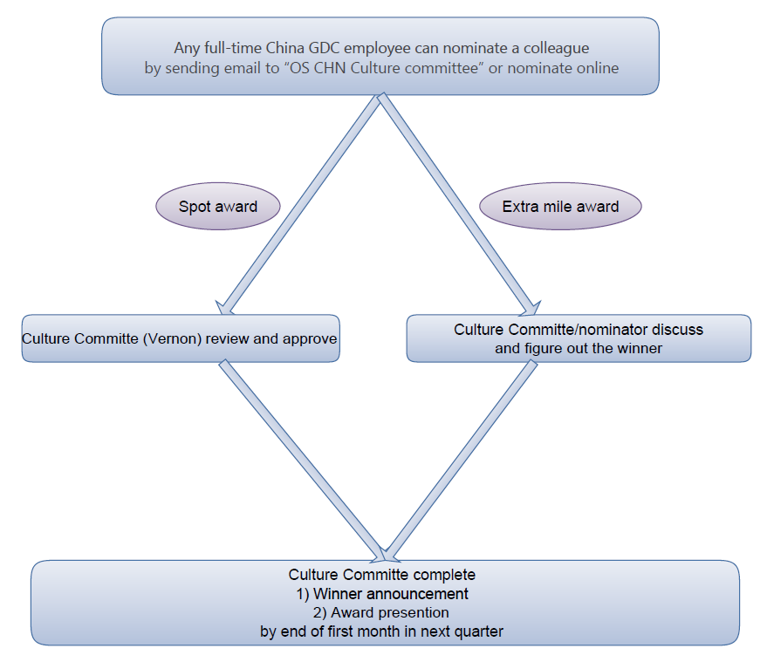
Nomination process

Slide 6

Please find more in:
https://sharepoint.perficient.com/myperficient/culture/default.aspx

Slide 7
Questions?

